Slide 1

Brain Tumor Segmentation and Classification
“ The Gradients”
Team Members: Abjasree S, Poojan Smart, Niranjan Solanki, Vaishnav Panuganti

Slide 2

Problem Statement
03
01
Models and Performance
02
Losses and Evaluation metrics
04
Results and Conclusion

Slide 3

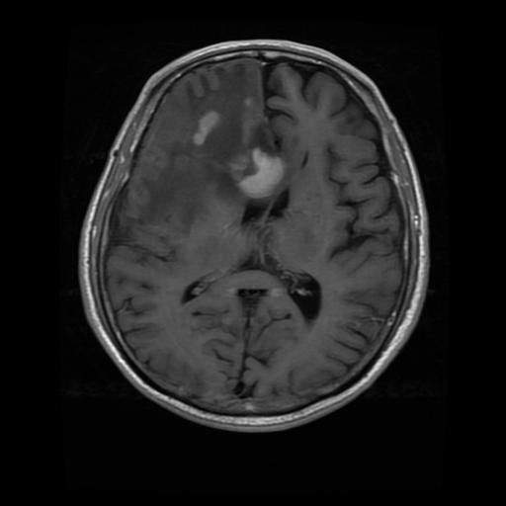
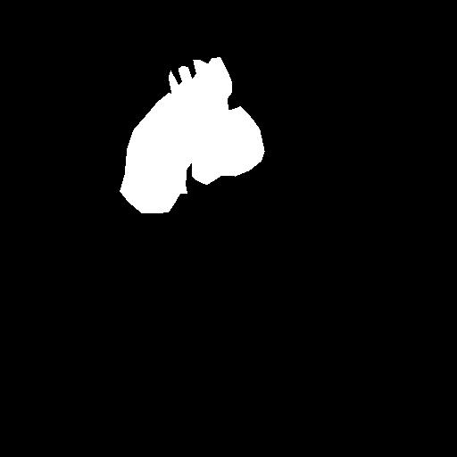
Problem Statement
Dataset
Segment the tumor part from the MRI scans of brain.
Identify the kind of brain tumor from categories : Meningioma, Glioma, Pituitary tumor
3064 T1-weighted contrast enhanced images 512 x 512 x 1
233 patients with three types of tumors
Meningioma (708 slices)
Glioma (1426 slices)
Pituitary tumor (930 slices)
MRI Scan
Tumor Mask

Slide 4
Loss and Evaluation Metric
Imbalance of class at pixel level
Class: 1
Loss :
Binary cross-entropy
+
Focul loss
+
Dice Loss
Balances the loss for each class
Class: 0
Log loss
Gives more loss for predictions that are far away from actual.
Unbalanced Classification
Metric :
Mean IoU
Mean over the IoU of each class (in our case, Tumor region and Non-Tumor region). Therefore It is a balanced metric.

Slide 5
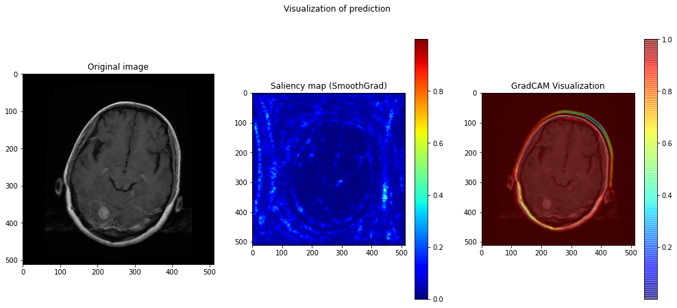
Models and Performance
Base Models
Classification
Accuracy was very low i.e., even less than 0.5
FFNN
CNN
Got accuracy around 0.8965
Saliency maps depicts it takes the whole information of brain
We want the location of tumor and information on tumor for classification
Led to using semantic segmentation using UNET

Slide 6
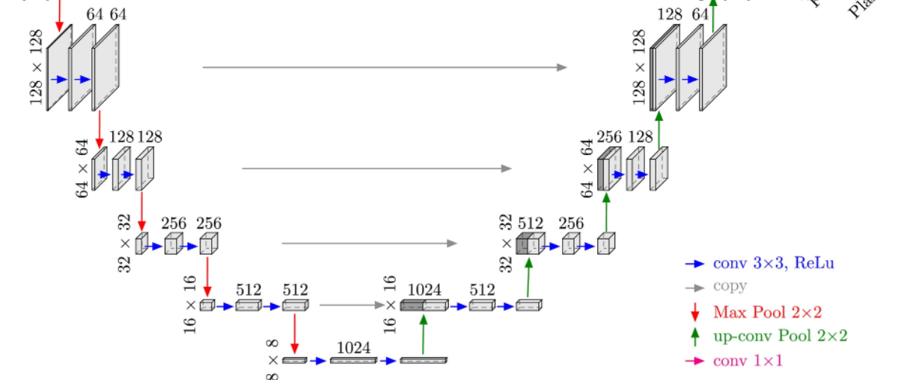
Semantic Segmentation
UNET Architecture
Loss: 0.532
Mean IOU : 0.8353
Basic Autoencoder
Simple UNET
Loss: 0.3813
Mean IOU : 0.8499
Loss: 0.3113
Mean IOU : 0.8442
UNET with batchnorm
Precise locations: Use of skip connections i.e., concatenating output of transpose convolution with feature maps from the encoder of same level
Transfer Learning
Loss: 0.3149
Mean IOU : 0.6266

Slide 7
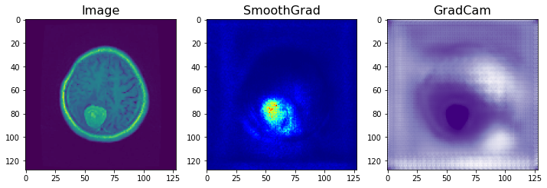
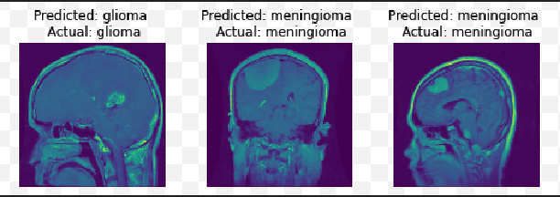
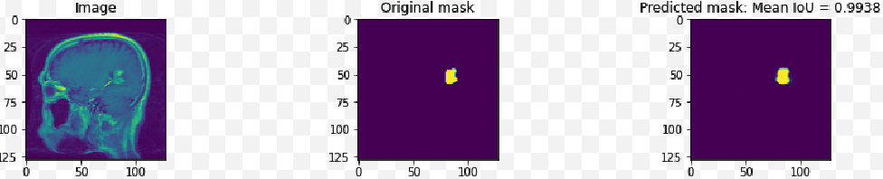
Classification from encoded layer of UNET
We want classification based on tumor information
Trying classification using encoded layer of UNET
Accuracy: 0.853
Simple UNET
UNET with batchnorm
Accuracy: 0.9159
HYPOTHESIS
We are segmenting the image to the same space dimension, so the information about the location of tumor is preserved

Slide 8
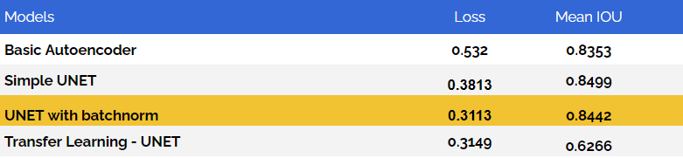
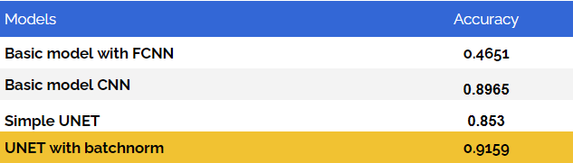
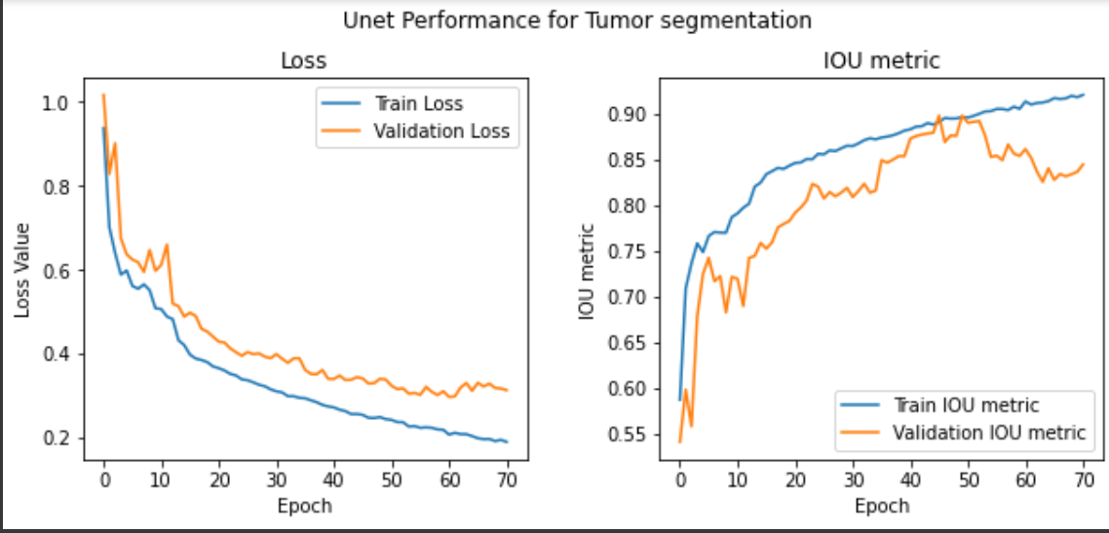
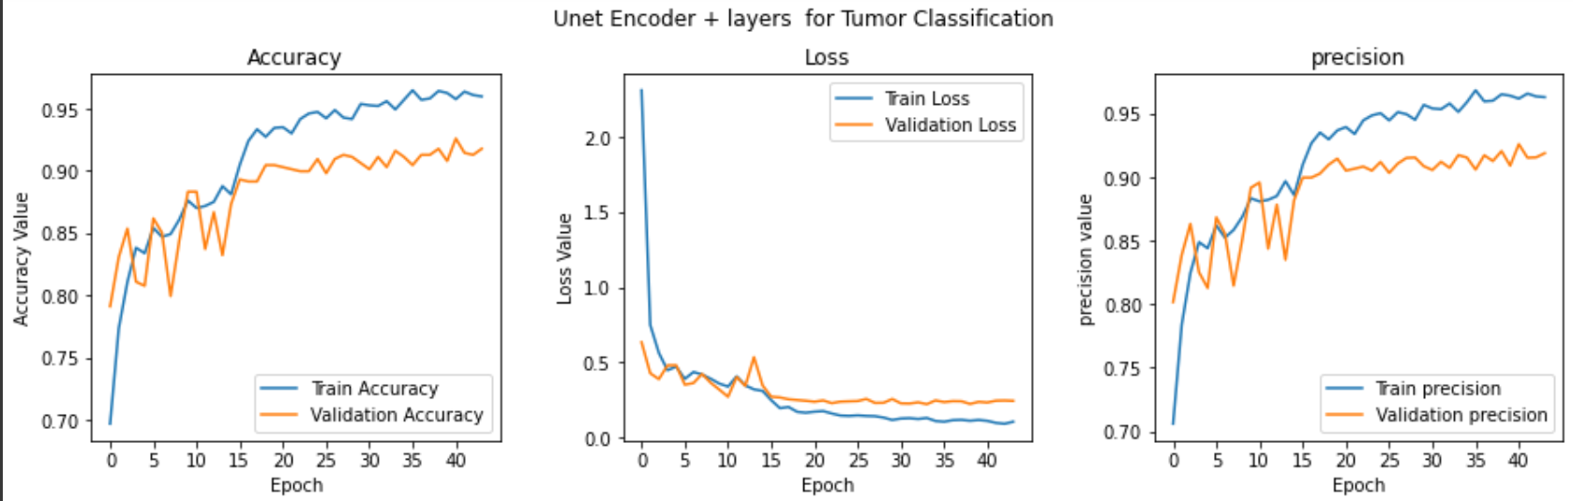
Results
Segmentation
Classification

Slide 9
Conclusion and Inference
AutoEncoder
Mean IOU
Using Base autoencoder we couldn’t achieve the good Saliency map but for UNET we could
We have used mean iou metric for segmentation because the tumor and non-tumor pixels are unbalanced
Best Model
Loss
The model, UNET with batch norm and data augmentation gave the best result for the data
Addition of three losses give good result compared to using individual loss

Slide 10
IMPROVEMENTS
Improve the Classification
Improve the shape
We can try improving the classification part by analysing the incorrect label.
We can work on improving the shape of the tumor while segmentation
Transfer learning
Data augmentation
Train for more epochs since the graph seems improving
Try with new data and do data augmentation according to the data

Slide 11
THANKS!
Team Members
Abjasree S
Poojan Smart
Niranjan Solanki
Vaishnav Panuganti

